Slide 1
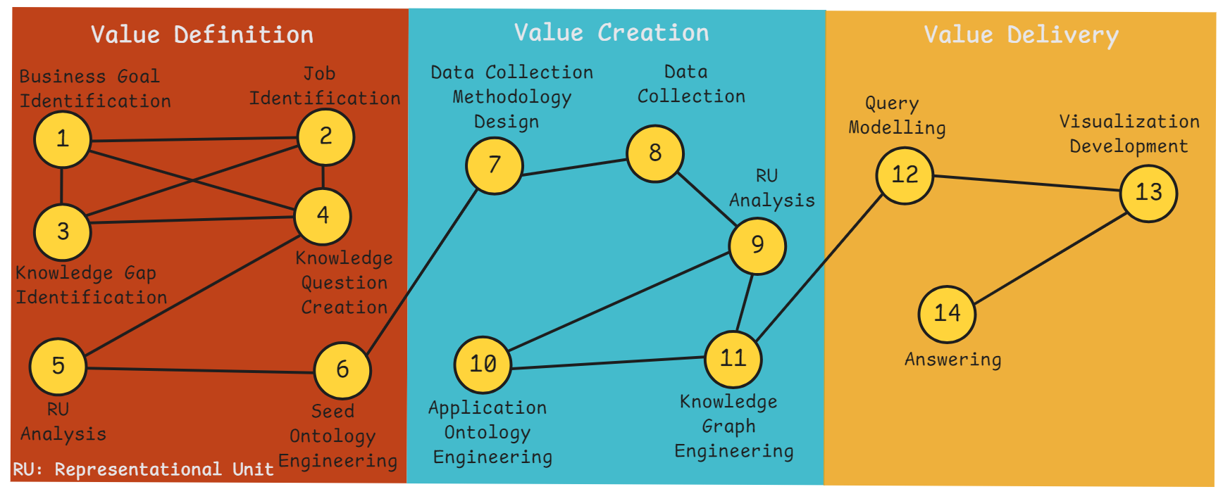

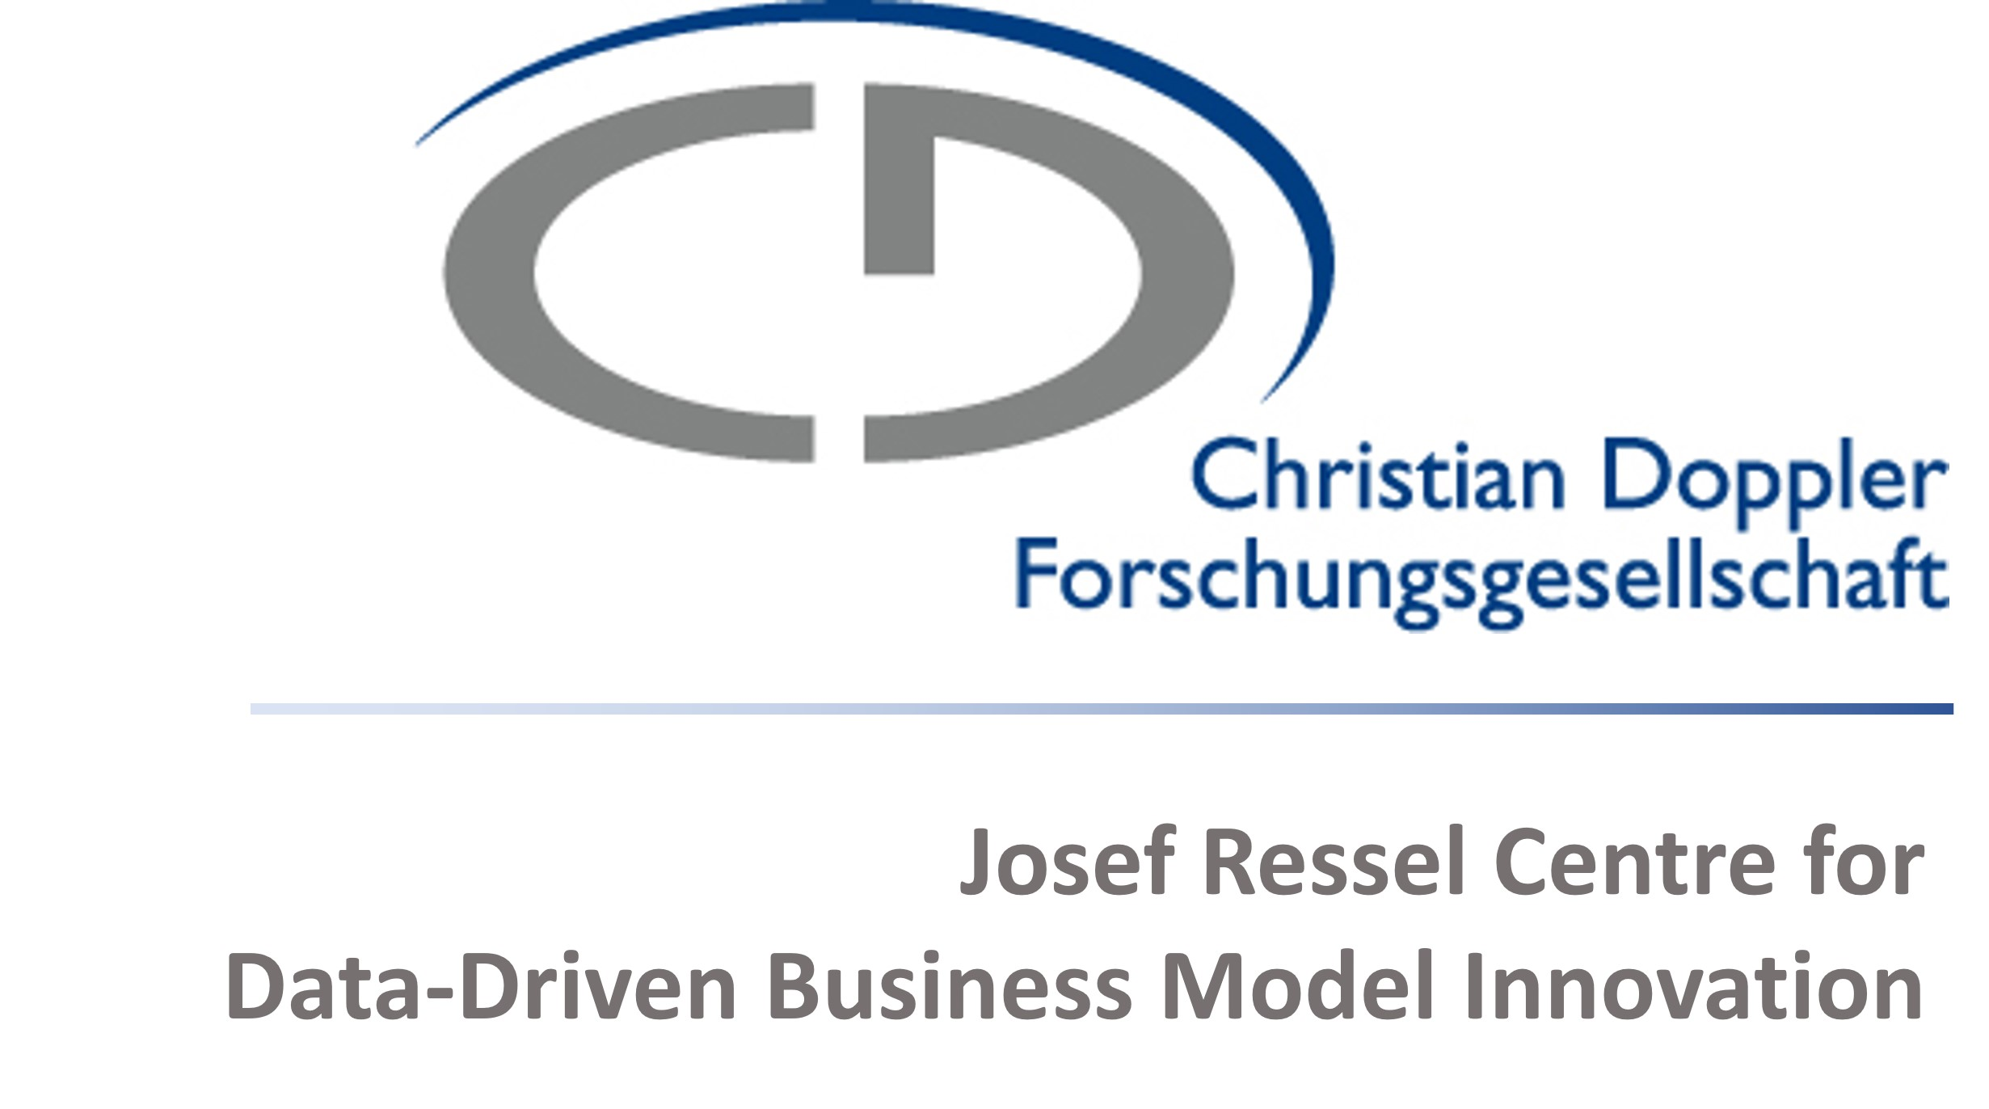

BEAR: Value-First Ontology Engineering Framework for Business Ecosystem Analysis and Representation
ISWC 2025 Workshop: WOP 2025
Title: BEAR: Value-First Ontology Engineering Framework for Business Ecosystem Analysis and Representation
Alican Tüzün

Slide 2
Problem

Slide 3
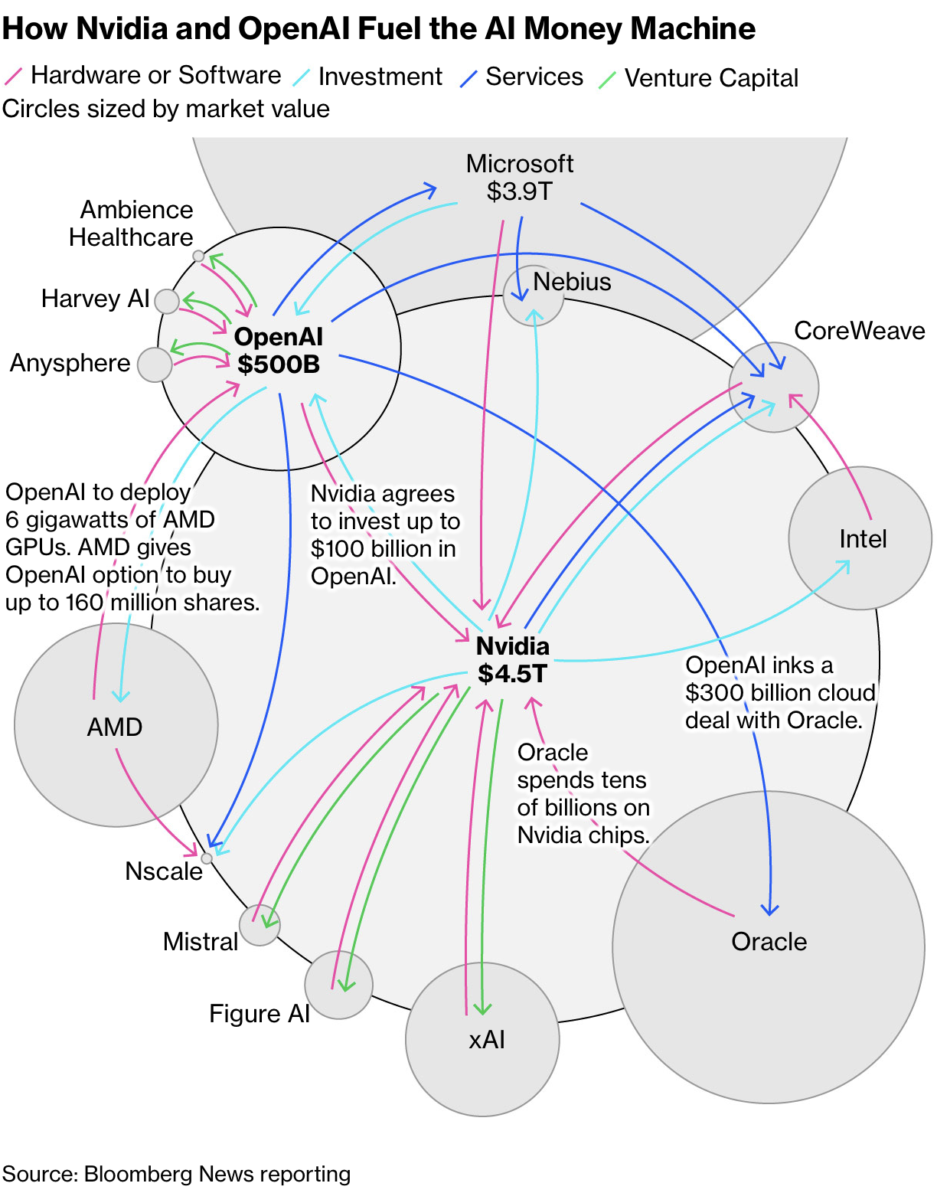

Slide 5
What is going on?

Slide 6
Problem

Slide 7
A blind spot

Slide 11
Solution

Slide 12
Good Old Ontology Engineering

Slide 13
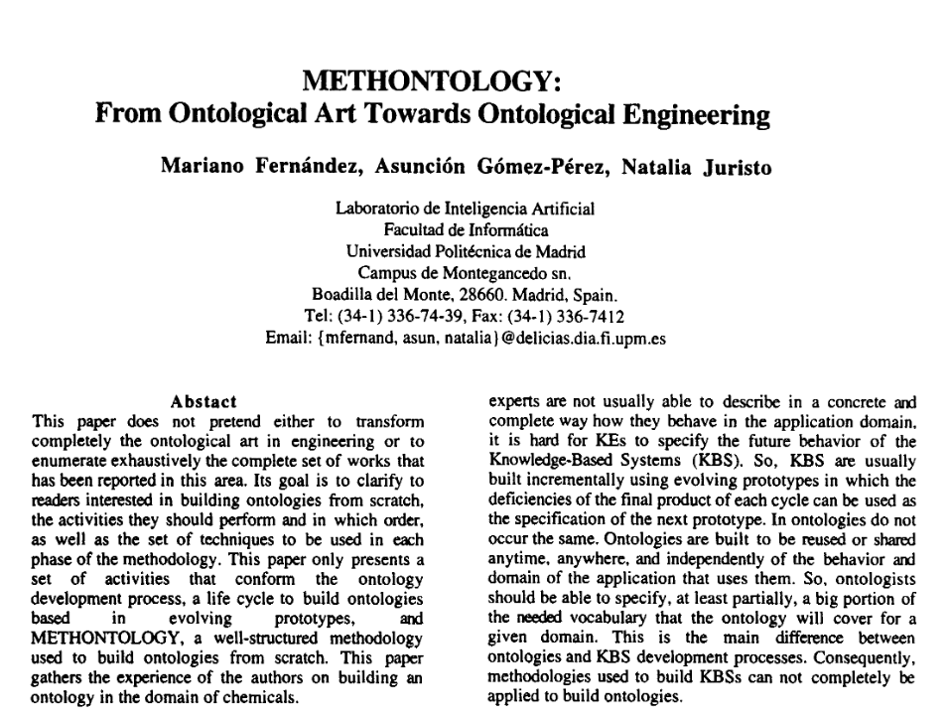

Slide 14
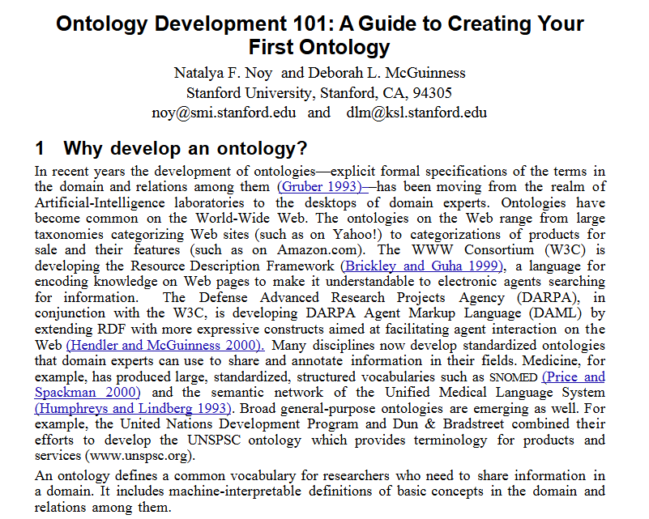

Slide 15
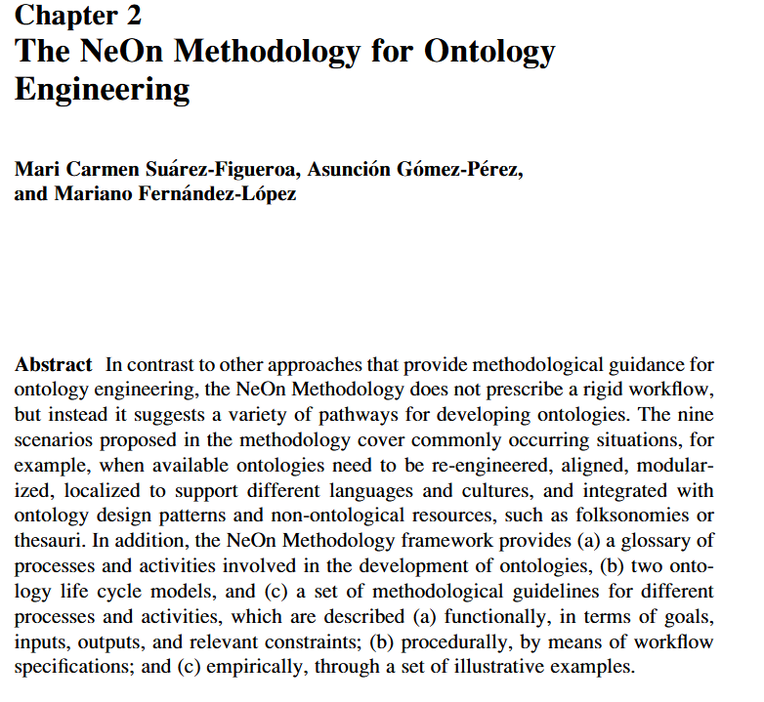

Slide 16
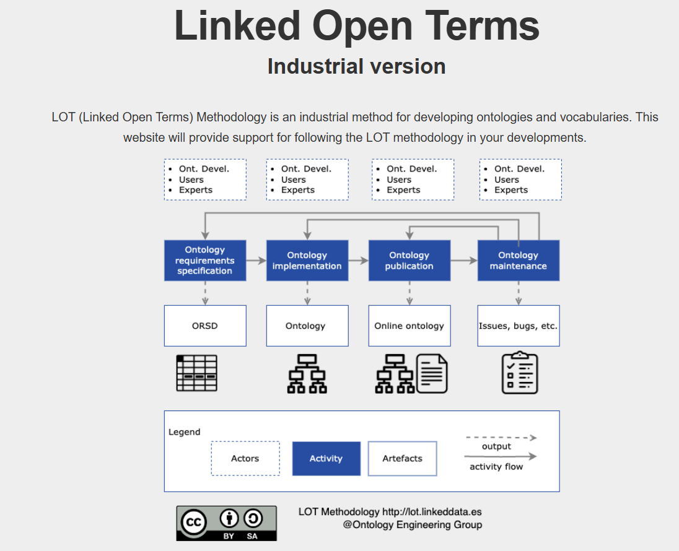

Slide 17
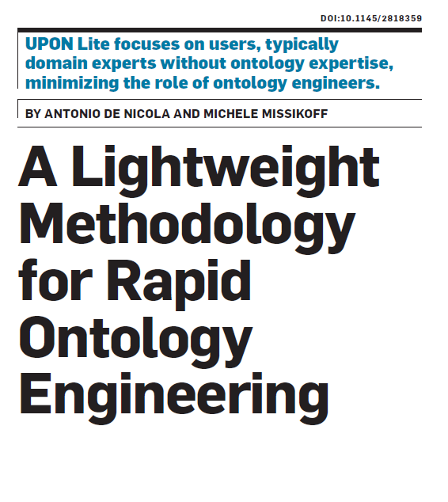

Slide 18
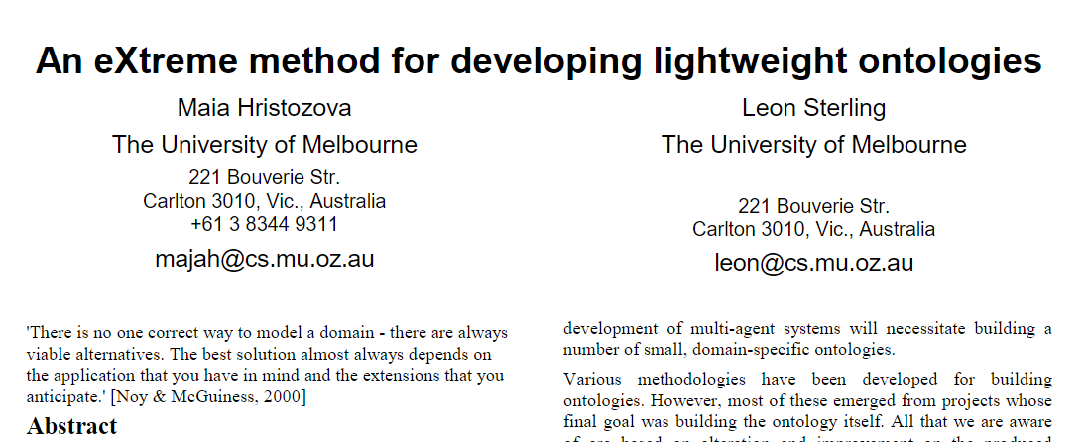

Slide 19
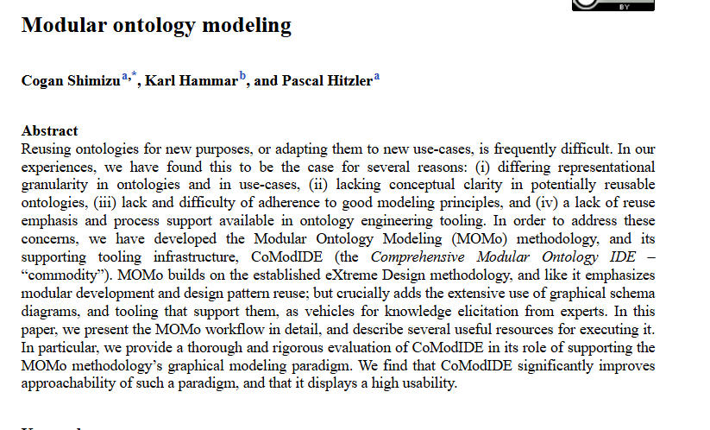

Slide 20
Problem

Slide 21
The Traditionalists (e.g.,METHONTOLOGY)
Notes:
"The first generation, with methodologies like METHONTOLOGY, aimed to build comprehensive Domain Ontologies. Think of these as the definitive 'encyclopedia' for a field—like biology or manufacturing. The goal was a reusable, long-lasting knowledge asset.“
"While noble, this was incredibly difficult and slow. It was like trying to write the entire encyclopedia before you could answer a single question."

Slide 22
The Traditionalists (e.g.,METHONTOLOGY)
"What must this ontology represent?"
Notes:
"The first generation, with methodologies like METHONTOLOGY, aimed to build comprehensive Domain Ontologies. Think of these as the definitive 'encyclopedia' for a field—like biology or manufacturing. The goal was a reusable, long-lasting knowledge asset.“
"While noble, this was incredibly difficult and slow. It was like trying to write the entire encyclopedia before you could answer a single question."

Slide 23
The Traditionalists (e.g.,METHONTOLOGY)
"What must this ontology represent?“
A formal, reusable ontology.
Notes:
"The first generation, with methodologies like METHONTOLOGY, aimed to build comprehensive Domain Ontologies. Think of these as the definitive 'encyclopedia' for a field—like biology or manufacturing. The goal was a reusable, long-lasting knowledge asset.“
"While noble, this was incredibly difficult and slow. It was like trying to write the entire encyclopedia before you could answer a single question."

Slide 24
The Agilists
(e.g., eXtreme Design)

Slide 25
The Agilists
(e.g., eXtreme Design)
"What must this ontology do for our system?"

Slide 26
The Agilists
(e.g., eXtreme Design)
"What must this ontology do for our system?"
A lean, application-specific
ontology.

Slide 27
Where is the problem?

Slide 28
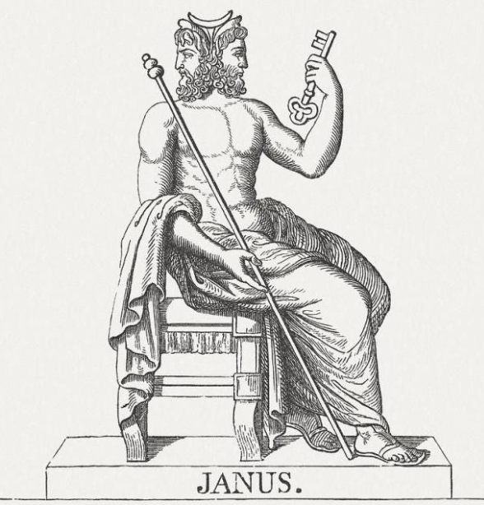

Slide 29
The Domain of
Decision-Maker
The Domain of
Modelist
Looks at market opportunities,
risk, and growth.
Asks: "Is the decision
right?“
Speaks the language of
Strategic Goals.
Uses Natural Language
Looks at structures,
logic, and completeness.
Asks: "Is the model
correct?"
Speaks the language of
Engineering.
Uses Formal Language

Slide 30
"Can the ontology represent a product delivery relationship between two companies?„
"Can we list all the bearing manufacturers that deliver to generator manufacturers?"
"How do specific companies
establish their positions through product/service delivery interactions within the wind energy ecosystem?”
Notes:
Traditional and even Agile methodologies were overwhelmingly one-faced. They were designed by engineers, for engineers, with a deep focus on the technical face. They lacked a true second face to look outward and speak the language of business value.

Slide 31
The Domain of
Decision-Maker
The Domain of
Modelist
Looks at market opportunities,
risk, and growth.
Asks: "Is the decision
right?“
Speaks the language of
Strategic Goals.
Uses Natural Language
Looks at structures,
logic, and completeness.
Asks: "Is the model
correct?"
Speaks the language of
Engineering.
Uses formal language

Slide 32
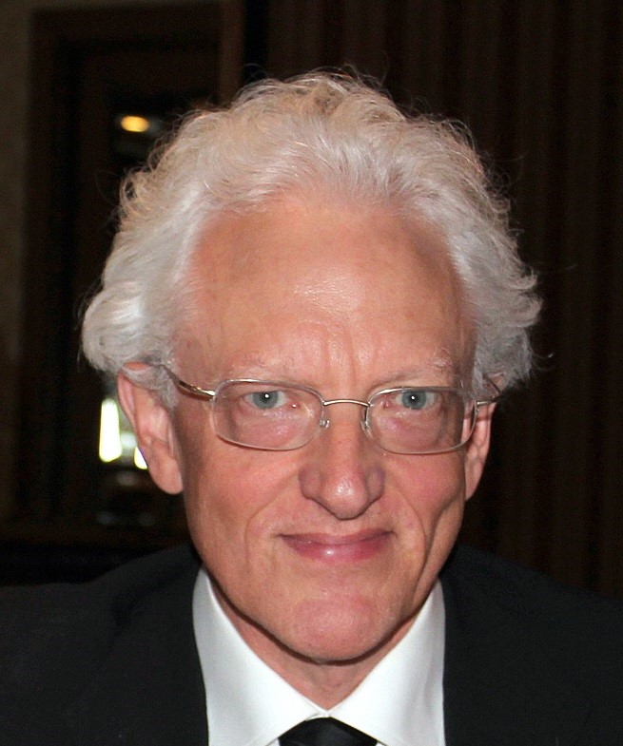
Notes:
Then the C level guy will come to you and ask

Slide 33
So What?

Slide 34
The Solution

Slide 35
BEAR: Value-First Ontology Engineering Framework (for Business Ecosystem Analysis and Representation)

Slide 36
Notes:
The BEAR framework has three core processes: Value Definition, Creation, and Delivery. Undirected edges in the figure represent the iterative nature of the subprocesses and temporal proximity. The process moves from left to right through three phases. (1) The value definition process begins by identifying a stakeholder’s business goals,jobs, and knowledge gaps to formulate a specific knowledge question and formalize it into a seed ontology. (2)Value Creation process uses that seed ontology to guide data collection and engineer a targeted knowledge graph. (3) Value Delivery process delivers the answer to a knowledge question through query modeling and tailored visualizations, revealing strategic insights.

Slide 37
Notes:
The BEAR framework has three core processes: Value Definition, Creation, and Delivery. Undirected edges in the figure represent the iterative nature of the subprocesses and temporal proximity. The process moves from left to right through three phases. (1) The value definition process begins by identifying a stakeholder’s business goals,jobs, and knowledge gaps to formulate a specific knowledge question and formalize it into a seed ontology. (2)Value Creation process uses that seed ontology to guide data collection and engineer a targeted knowledge graph. (3) Value Delivery process delivers the answer to a knowledge question through query modeling and tailored visualizations, revealing strategic insights.

Slide 38
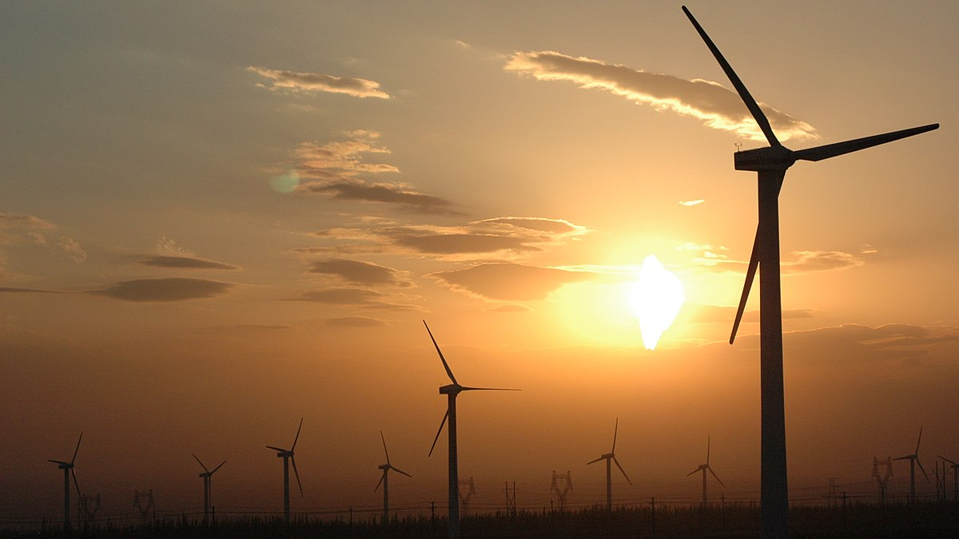
Notes:
The BEAR framework has three core processes: Value Definition, Creation, and Delivery. Undirected edges in the figure represent the iterative nature of the subprocesses and temporal proximity. The process moves from left to right through three phases. (1) The value definition process begins by identifying a stakeholder’s business goals,jobs, and knowledge gaps to formulate a specific knowledge question and formalize it into a seed ontology. (2)Value Creation process uses that seed ontology to guide data collection and engineer a targeted knowledge graph. (3) Value Delivery process delivers the answer to a knowledge question through query modeling and tailored visualizations, revealing strategic insights.

Slide 39
Notes:
Part_of Subprocesses

Slide 40
BEAR’s value definition process begins by treating decision makers as customers

Slide 41
1
Business Goal Identification
Goals that are strategic, informal objectives, expressed in natural language.
Notes:
Business goal refers to a specification here.

Slide 42
1
Business Goal Identification
To drive revenue growth in the increasingly crowded wind energy ecosystem
Notes:
Business goal refers to a specification here.

Slide 43
2
Job Identification
a progress a customer is trying to make in a given circumstance to advance their goals

Slide 44
2
Job Identification
Help us see the hidden relationships of our ecosystem so we can confidently identify new, high-margin service opportunities and stop wasting resources and company capabilities on low-probability bets.
Notes:
It may seem dramatic, but let them speak.

Slide 45
3
Knowledge Gap Identification
A gap that prevents them from completing that job successfully, facilitating progress toward their goals.
Notes:
It may seem dramatic, but let them speak.

Slide 46
3
Knowledge Gap Identification
Company positions within wind energy ecosystem achieved through product/service delivery interactions
Notes:
It may seem dramatic, but let them speak.

Slide 47
4
Knowledge Question Creation
Formulating the gaps into single, consensus-driven knowledge question
Notes:
It may seem dramatic, but let them speak.

Slide 48
4
Knowledge Question Creation
How do specific companies establish their positions through product/service delivery interactions within the windenergy ecosystem?
Notes:
It may seem dramatic, but let them speak.

Slide 49
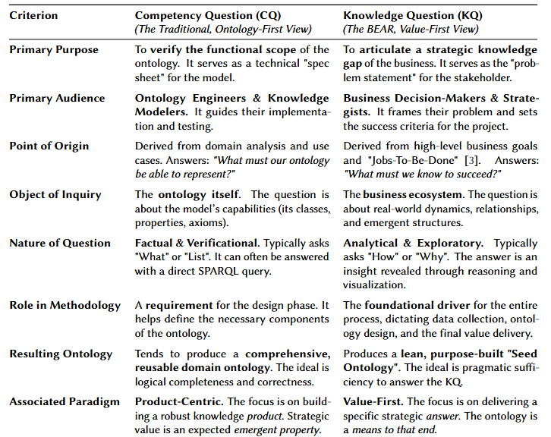
4

Slide 51
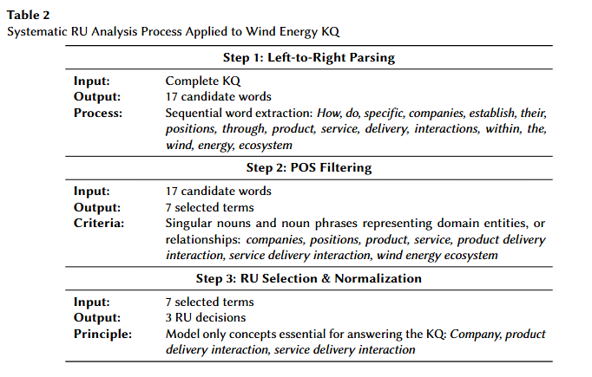
5
Representational Unit Analysis
Notes:
It may seem dramatic, but let them speak.

Slide 52
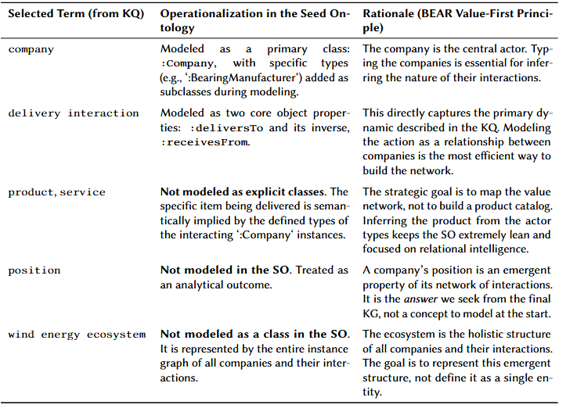
6
Seed Ontology Engineering
Notes:
It may seem dramatic, but let them speak.

Slide 53
DANGER
Notes:
Formulating the gaps into single, consensus-driven knowledge question

Slide 54
Notes:
The BEAR framework has three core processes: Value Definition, Creation, and Delivery. Undirected edges in the figure represent the iterative nature of the subprocesses and temporal proximity. The process moves from left to right through three phases. (1) The value definition process begins by identifying a stakeholder’s business goals,jobs, and knowledge gaps to formulate a specific knowledge question and formalize it into a seed ontology. (2)Value Creation process uses that seed ontology to guide data collection and engineer a targeted knowledge graph. (3) Value Delivery process delivers the answer to a knowledge question through query modeling and tailored visualizations, revealing strategic insights.

Slide 55
Notes:
The BEAR framework has three core processes: Value Definition, Creation, and Delivery. Undirected edges in the figure represent the iterative nature of the subprocesses and temporal proximity. The process moves from left to right through three phases. (1) The value definition process begins by identifying a stakeholder’s business goals,jobs, and knowledge gaps to formulate a specific knowledge question and formalize it into a seed ontology. (2)Value Creation process uses that seed ontology to guide data collection and engineer a targeted knowledge graph. (3) Value Delivery process delivers the answer to a knowledge question through query modeling and tailored visualizations, revealing strategic insights.

Slide 56
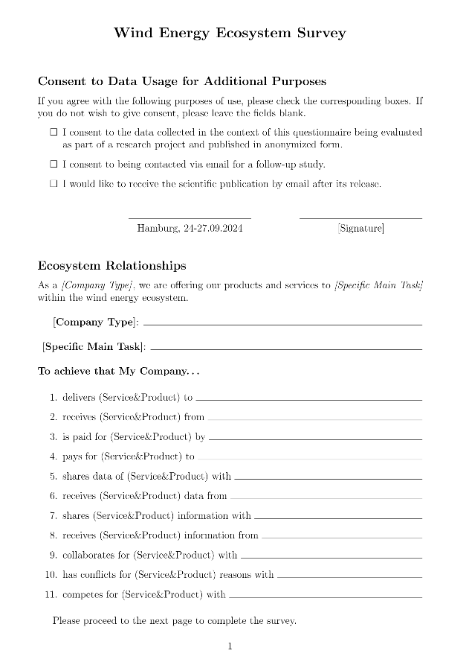
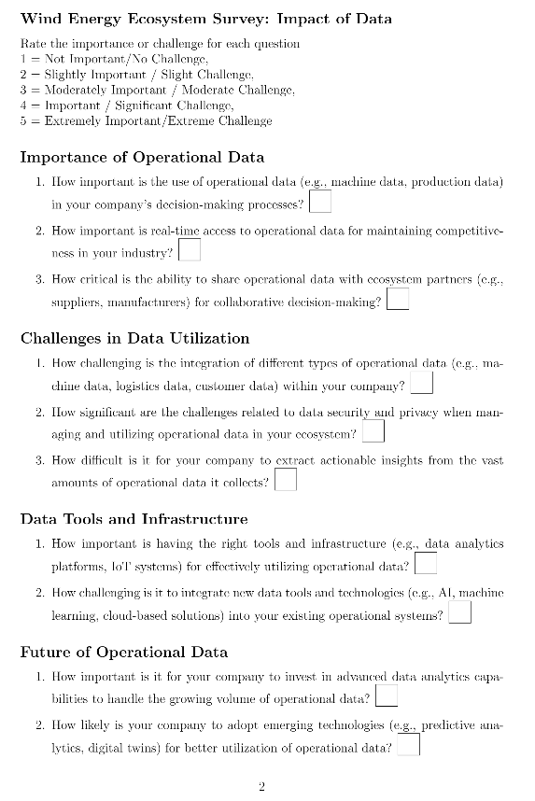
7
Data Collection Methodology Design
Notes:
It may seem dramatic, but let them speak.

Slide 57
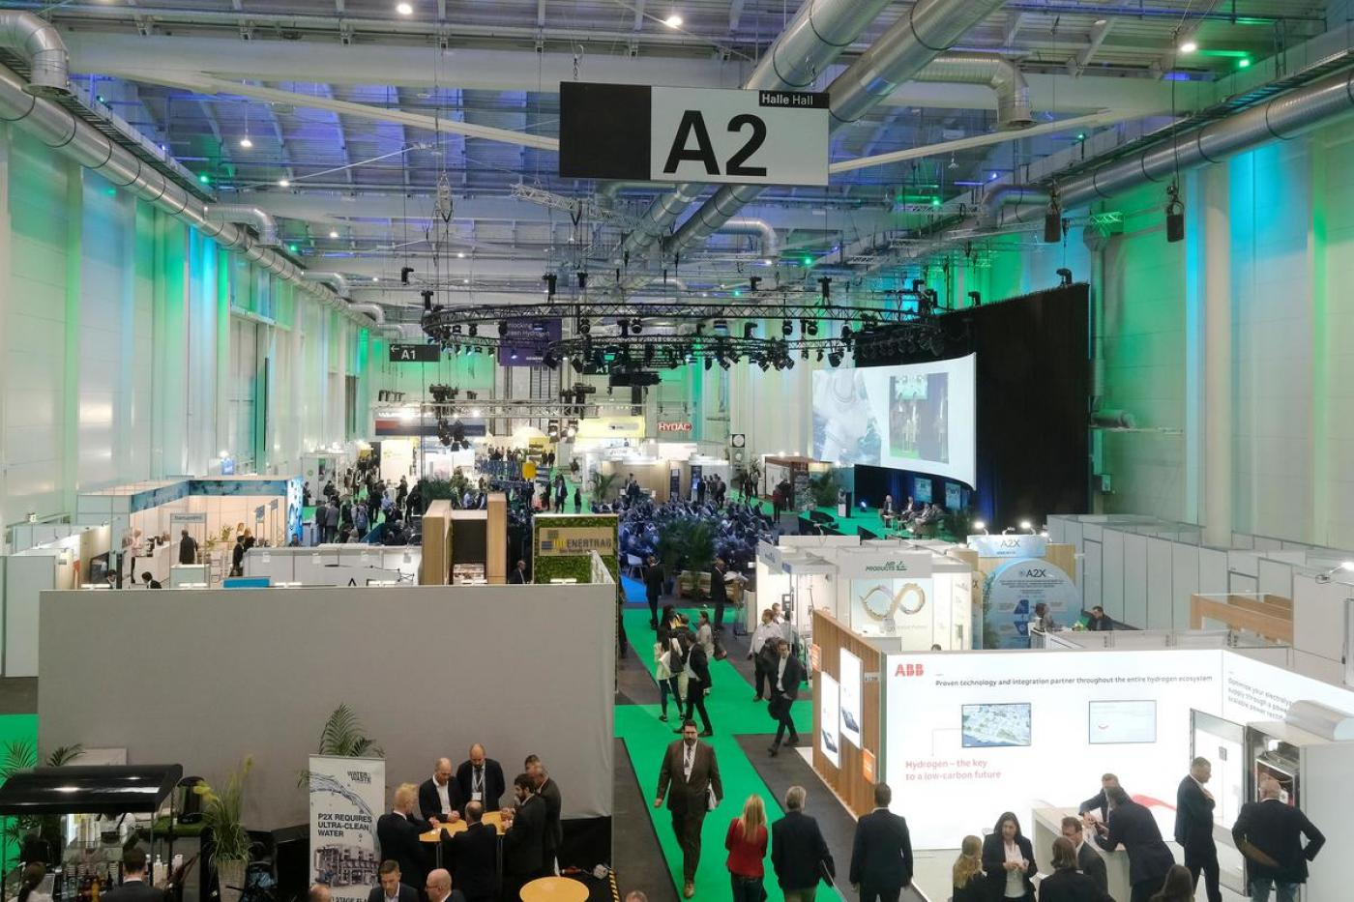
8
Data Collection
Notes:
It may seem dramatic, but let them speak.

Slide 58
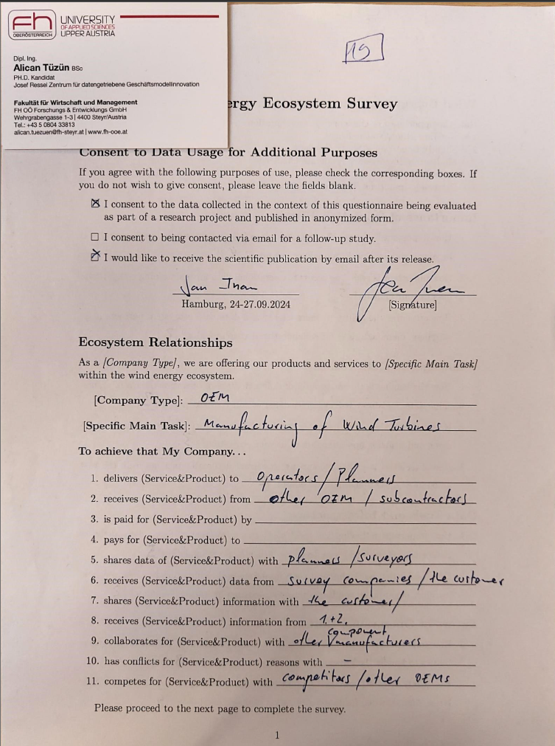
7
8

Slide 59
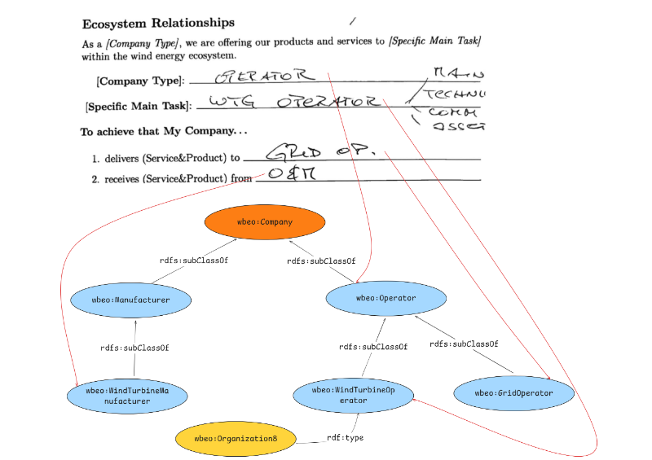
9
Representational Unit Analysis
Notes:
It may seem dramatic, but let them speak.

Slide 60
10
Ontology Engineering
Notes:
It may seem dramatic, but let them speak.

Slide 61
Notes:
It may seem dramatic, but let them speak.

Slide 62
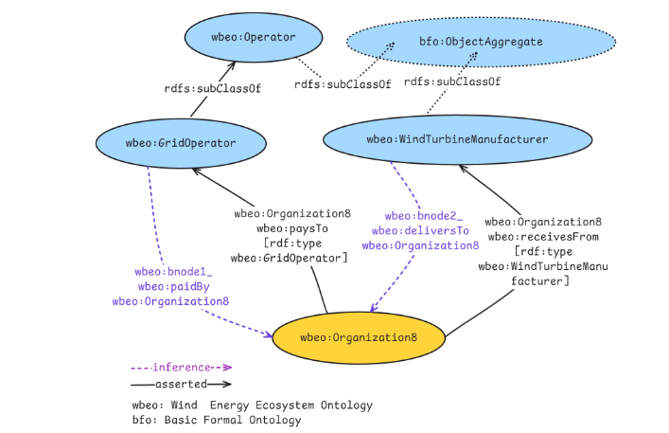
11
Knowledge Graph Engineering
Notes:
It may seem dramatic, but let them speak.

Slide 63
Notes:
It may seem dramatic, but let them speak.

Slide 64
Notes:
The BEAR framework has three core processes: Value Definition, Creation, and Delivery. Undirected edges in the figure represent the iterative nature of the subprocesses and temporal proximity. The process moves from left to right through three phases. (1) The value definition process begins by identifying a stakeholder’s business goals,jobs, and knowledge gaps to formulate a specific knowledge question and formalize it into a seed ontology. (2)Value Creation process uses that seed ontology to guide data collection and engineer a targeted knowledge graph. (3) Value Delivery process delivers the answer to a knowledge question through query modeling and tailored visualizations, revealing strategic insights.

Slide 65
Notes:
The BEAR framework has three core processes: Value Definition, Creation, and Delivery. Undirected edges in the figure represent the iterative nature of the subprocesses and temporal proximity. The process moves from left to right through three phases. (1) The value definition process begins by identifying a stakeholder’s business goals,jobs, and knowledge gaps to formulate a specific knowledge question and formalize it into a seed ontology. (2)Value Creation process uses that seed ontology to guide data collection and engineer a targeted knowledge graph. (3) Value Delivery process delivers the answer to a knowledge question through query modeling and tailored visualizations, revealing strategic insights.

Slide 66
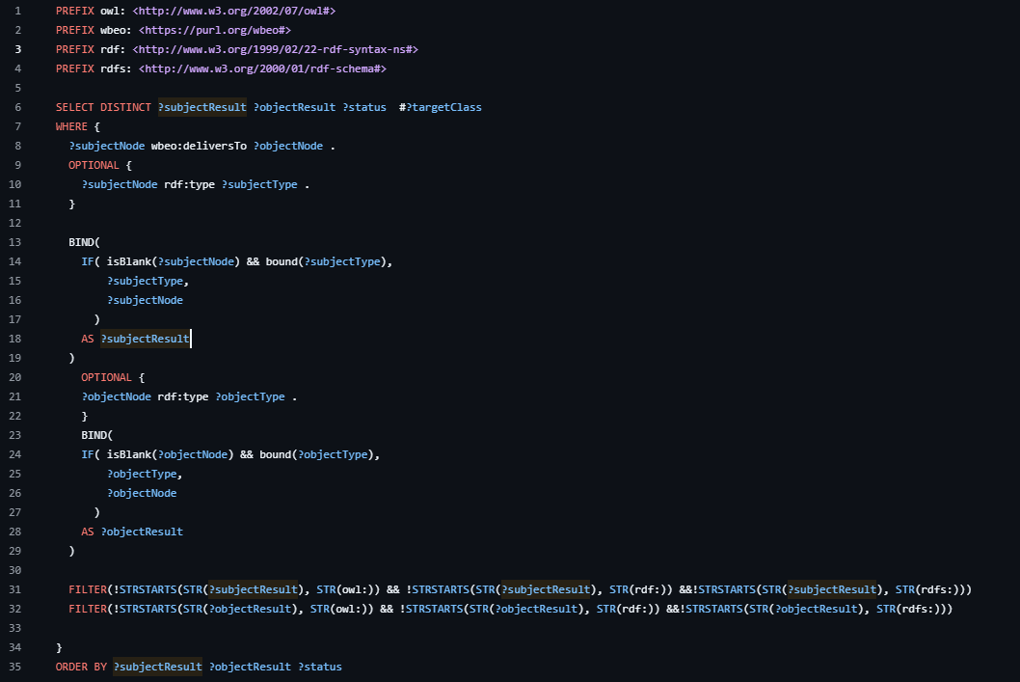
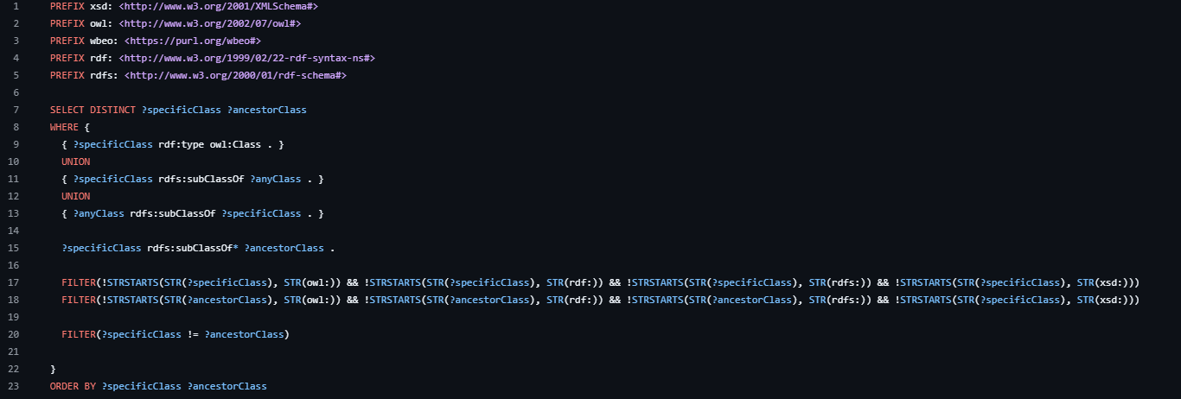
11
Query Modelling
Notes:
It may seem dramatic, but let them speak.

Slide 67
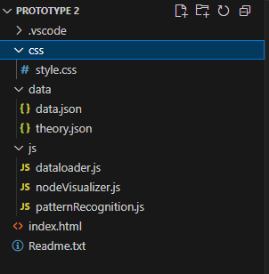
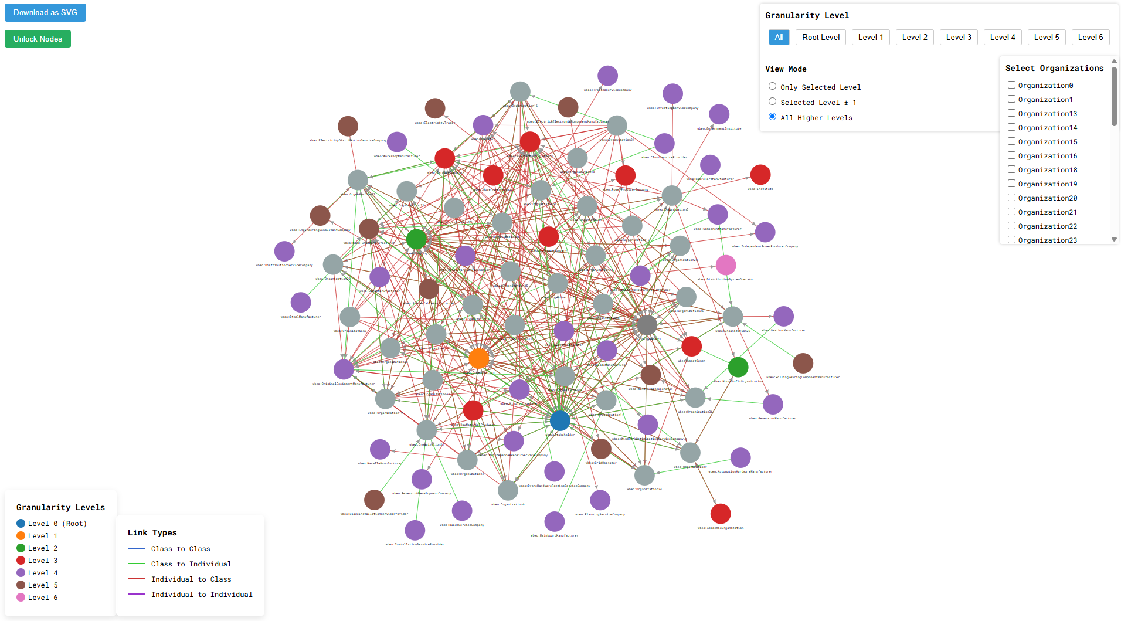
12
Visualization Development
Notes:
It may seem dramatic, but let them speak.

Slide 68
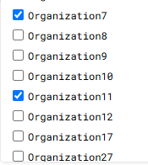
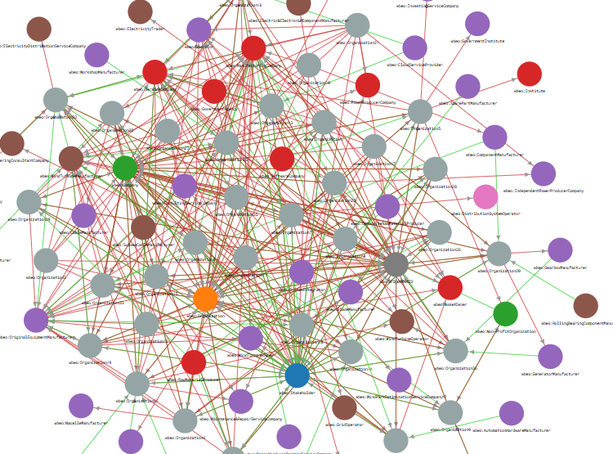
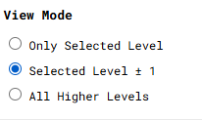
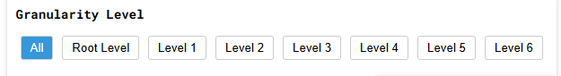
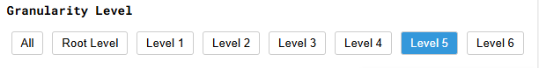
13
Answering the KQ
Notes:
It may seem dramatic, but let them speak.

Slide 69
4
Knowledge Question Creation
How do specific companies establish their positions through product/service delivery interactions within the wind energy ecosystem?
Notes:
It may seem dramatic, but let them speak.

Slide 70
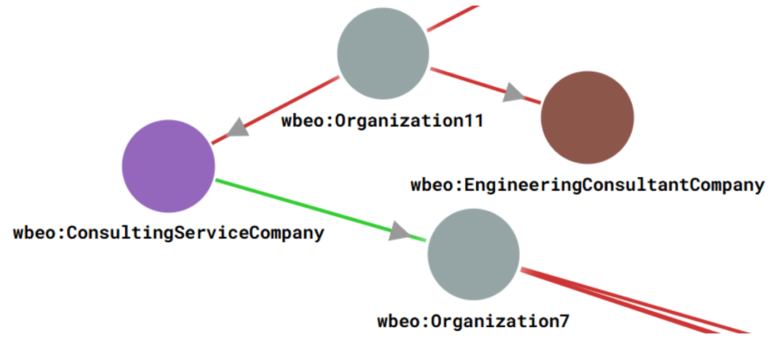
13
Answering the KQ

Slide 71
Notes:
The BEAR framework has three core processes: Value Definition, Creation, and Delivery. Undirected edges in the figure represent the iterative nature of the subprocesses and temporal proximity. The process moves from left to right through three phases. (1) The value definition process begins by identifying a stakeholder’s business goals,jobs, and knowledge gaps to formulate a specific knowledge question and formalize it into a seed ontology. (2)Value Creation process uses that seed ontology to guide data collection and engineer a targeted knowledge graph. (3) Value Delivery process delivers the answer to a knowledge question through query modeling and tailored visualizations, revealing strategic insights.

Slide 72
Future

Slide 73
Silo Problem

Slide 74
Quality Metrics

Slide 75
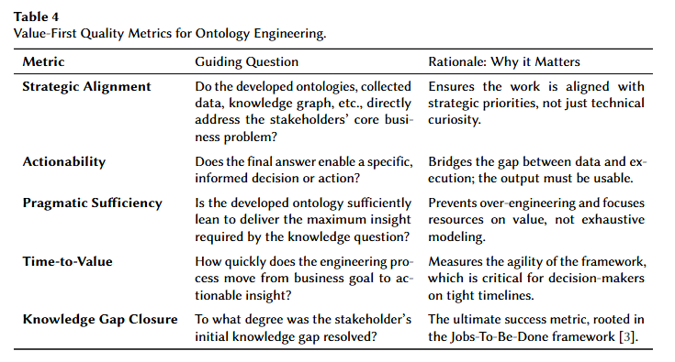

Slide 77
Philosophical Problem

Slide 78
Thank You!

Slide 79

BEAR: Value-First Ontology Engineering Framework for Business Ecosystem Analysis and Representation
ISWC 2025 Workshop: WOP 2025
Title: BEAR: Value-First Ontology Engineering Framework for Business Ecosystem Analysis and Representation
Alican Tüzün

